Slide 1
UNIT 2
Machine Learning

Slide 2
What is machine learning?
Machine learning (ML) is a subset of artificial intelligence (AI) that allows computers to learn and improve from data without being explicitly programmed. ML uses algorithms to analyze data, identify patterns, and make predictions. The more data a machine learning model is exposed to, the better it performs.

Slide 3
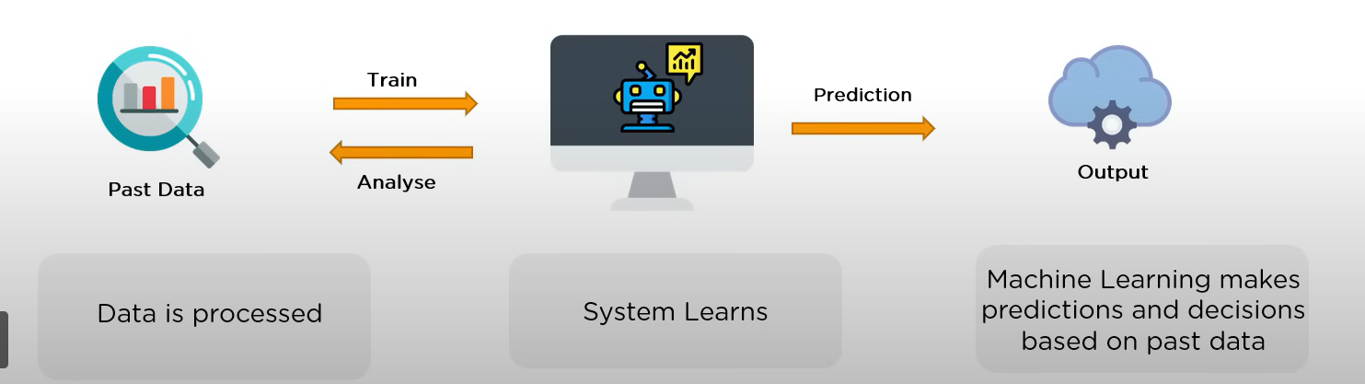
Example: Hey Siri, Where is the nearest pizza corner?

Slide 4
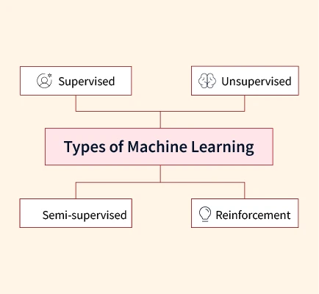
Types of machine learning

Slide 5
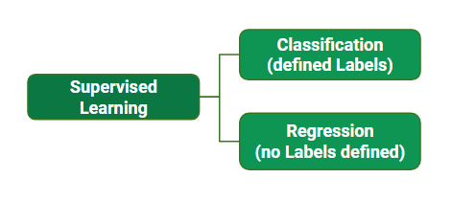
What is supervised learning?
Supervised machine learning is a machine learning technique that uses labeled data sets to train algorithms to predict outcomes and recognize patterns.
Example : Email spam detection
Class label: spam/not spam

Slide 6
Applications of Supervised machine learning
Face recognition
Fraud detection
Visual recognition
Risk assessment
What are the algorithms used?
Decision tree classification
Logistic regression
Support Vector Machine

Slide 7
Identify below applications whether classification or regression?
Identifying people based on pictures or voice recordings.
Recognizing birds based on their whistle.
Identifying profitable customers.
Identifying tumors and diseases.
Predicting the amount of money a person will spend on product X.
Predicting the number of eruptions of a volcano in a period.
Predicting your company’s yearly revenue.
Predicting which team will win the Champions League in soccer

Slide 8
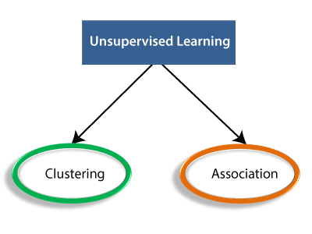
What is Unsupervised learning?
Unsupervised learning in artificial intelligence is a type of machine learning that learns from data without human supervision. Unlike supervised learning, unsupervised machine learning models are given unlabeled data and allowed to discover patterns and insights without any explicit guidance or instruction.

Slide 9
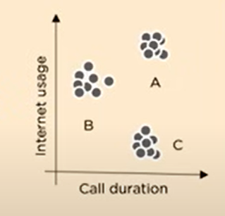
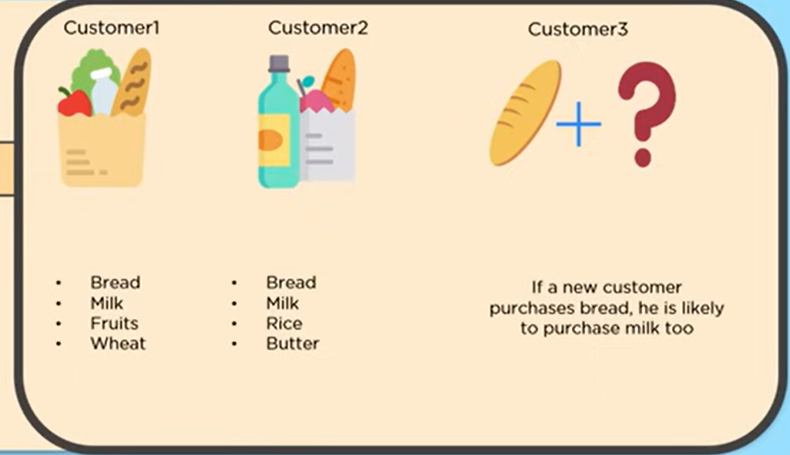
Clustering and Association

Slide 10
Applications of Unsupervised Learning
Market basket analysis
Semantic clustering
Delivery store optimization
Identify accident prone areas
What are the algorithms used?
K-means clustering
Hierarchical clustering
Apriori algorithm

Slide 11
Naïve bayes classification

Slide 12
K-means clustering

Slide 13
The modelling process
What is a model?
A model is a program that analyzes datasets to find patterns and make predictions.
The modelling process consists of 4 steps:
1 Feature engineering and model selection
2 Training the model
3 Model validation and selection
4 Applying the trained model to unseen data

Slide 14
Engineering features and selecting a model
Feature engineering is critical in building effective models. It involves creating, transforming, and combining raw variables into predictors that a model uses for its predictions.
Feature Creation
Features may be sourced from multiple datasets and require expert consultation or literature review.
Interaction variables (combining multiple inputs) can reveal significant effects otherwise unnoticed in single variables.
Feature Transformation
Raw data often requires preprocessing or transformation (Standardization)
Avoiding Availability Bias
Features should represent the entire truth, not just easily accessible data.

Slide 15
Some example of feature engineering
Roll No | 10th class | Inter
1 | 92 | 8.9
2 | 87 | 8.5
3 | 65 | 6.7
4 | 62 | 7.1
5 | 67 | 6.5
6 | 78 | 7.3
7 | 80 | 7.9
8 | 83 | 8.4
Roll No | 10th class | Inter
1 | 9.2 | 8.9
2 | 8.7 | 8.5
3 | 6.5 | 6.7
4 | 6.2 | 7.1
5 | 6.7 | 6.5
6 | 7.8 | 7.3
7 | 8 | 7.9
8 | 8.3 | 8.4
Data Transformation
Feature creation
Roll No | Performance
1 | Good
2 | Good
3 | Poor
4 | Poor
5 | Poor
6 | Average
7 | Good
8 | Good
Roll No | 10th class | Inter | Performance
1 | 9.2 | 8.9 | Good
2 | 8.7 | 8.5 | Good
3 | 6.5 | 6.7 | Poor
4 | 6.2 | 7.1 | Poor
5 | 6.7 | 6.5 | Poor
6 | 7.8 | 7.3 | Average
7 | 8 | 7.9 | Good
8 | 8.3 | 8.4 | Good

Slide 16
Training your model
Model training is the process of teaching a machine learning model to make accurate predictions by showing it data and adjusting its internal settings (weights) to minimize errors.
Supervised
Unsupervised
Semi supervised

Slide 17

Validating a model
Good Model Characteristics:
A good model should have strong predictive power and generalize well to unseen data.
Achieving this requires defining an error measure and a validation strategy.
Error Measures:
Classification Error Rate/Accuracy: Percentage of mislabeled observations in test data (lower is better).
Accuracy= Number of correct predictions in test data/ total prediction of test data
Mean Squared Error (MSE)/ Regression: Measures the average squared difference between predicted and actual values, emphasizing larger errors more significantly.

Slide 18
Validating a model cont..
Validation Strategies:
Train/Test Split: Divide data into training and holdout sets to test generalization.
K-Folds Cross-Validation: Divide data into k parts, using each as a test set once; ensures all data is used for training and testing.
Leave-One-Out Cross-Validation (LOOCV): A special case of k-fold with k=1; suitable for small datasets.

Slide 19
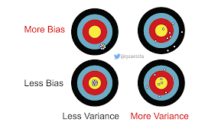
Bias and Variance
Bias is the difference between the actual value and predicted value.(Training error is more)
Variance is the measure of spread in data from its mean position.(Training error is less but test error is more)

Slide 20


Validating a model cont..
Regularization
Prevents overfitting by penalizing model complexity.
L1 Regularization (LASSO): Encourages models with fewer predictors, improving simplicity and robustness.
L2 Regularization (Ridge): Reduces variance among predictor coefficients, enhancing interpretability.

Slide 21
Validating a model cont..
Testing models on unseen, representative data is essential to evaluate their performance.
Tools like the confusion matrix are crucial for evaluating classification models
Once validated, models can optionally be used for future predictions.

Slide 22
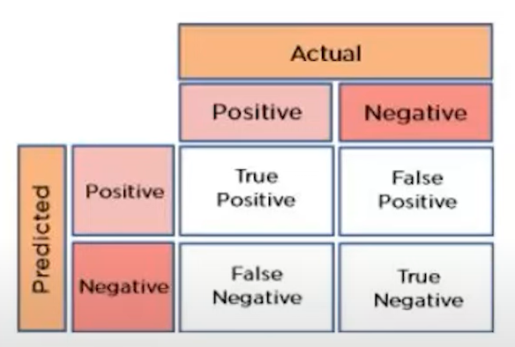
Confusion matrix
A confusion matrix is a two-dimensional matrix used in classification experiments to evaluate the performance of a system by showing the number of correctly and wrongly classified data

Slide 23
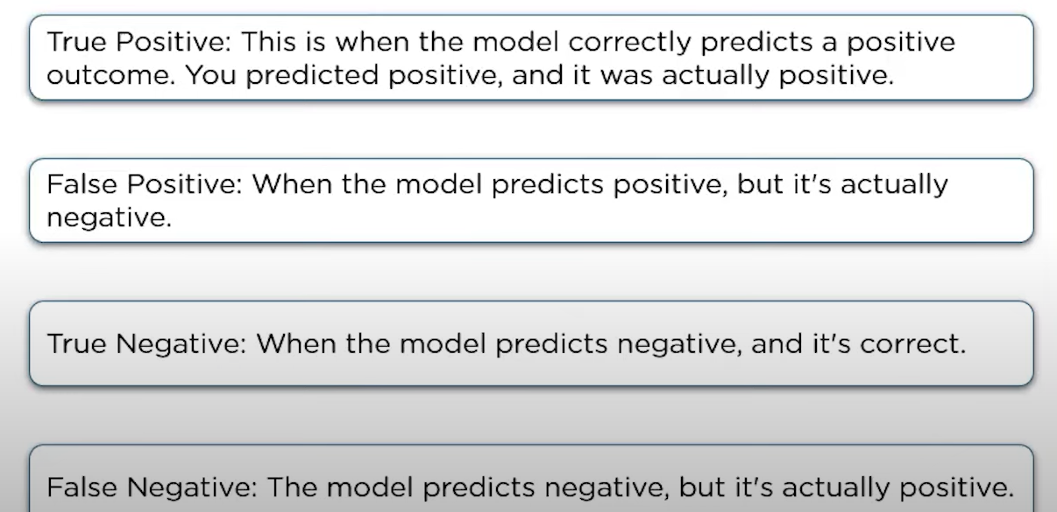

Slide 24

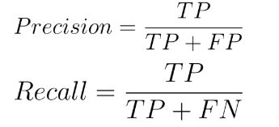
Actual
Actual
86 | 12
10 | 79
Predicted
Predicted

Slide 25
Predicting new observations
Model Scoring: Applying a trained model to predict outcomes on new data.
Consistent Data Prepration: New data must match the feature preparation used in training.
Model Trust: Validated models are ready for real-world use.

Slide 26
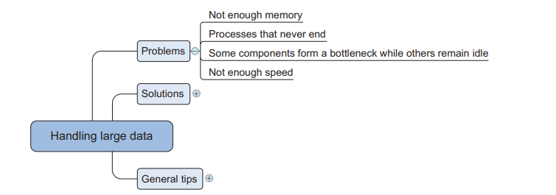
The problems you face when handling large data

Slide 27
The problems you face when handling large data
Memory Limitations: When data exceeds RAM, the OS swaps memory to disk, slowing performance; most algorithms aren’t designed for large data, leading to out-of-memory errors.
Time Constraints: Some algorithms run indefinitely or take unreasonably long to process even small data sets.
Bottlenecks: Certain components of the computer may be underutilized due to deadlock like situation
Storage Speed Issues: HDDs are slow, causing delays in data processing; SSDs help but are costly.

Slide 28
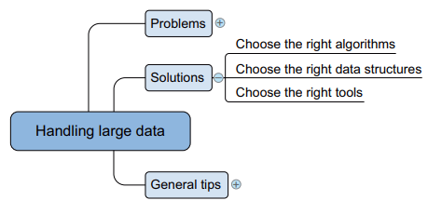
General techniques for handling large volumes of data

Slide 29
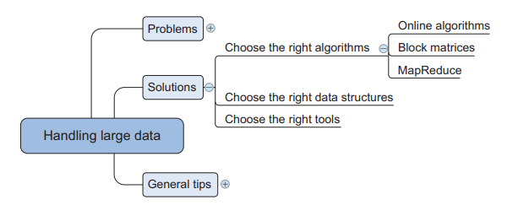
Choosing right algorithm

Slide 30
We have 3 different options to handle large data
Full batch learning(loading the complete dataset by increasing hardware features, but not a good practice)
Mini batch learning(taking the dataset in batches like 100, 1000 entries depending on our hardware)
Online learning(feed the algorithm one observation at a time)

Slide 31
Online algorithm
Some machine learning algorithms train on one observation at a time, updating the model and discarding the data. This "use and forget" approach solves memory issues, as single observations are too small to overwhelm modern computer memory.

Slide 32
Map reduce
Example – voting counting
Divides the large data set into smaller data sets and same Machine Learning model is applied on all the smaller data sets and the predictions are stored in a list.

Slide 33
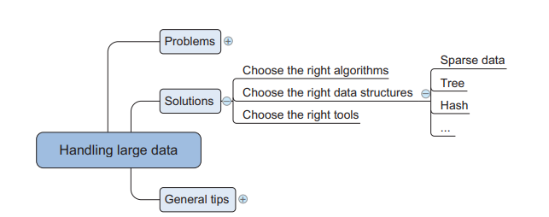
Choosing the right data structure

Slide 34
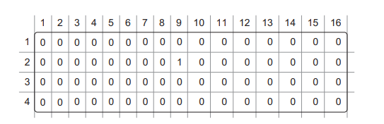
Sparse data
Data = [(2,9,1)]

Slide 35
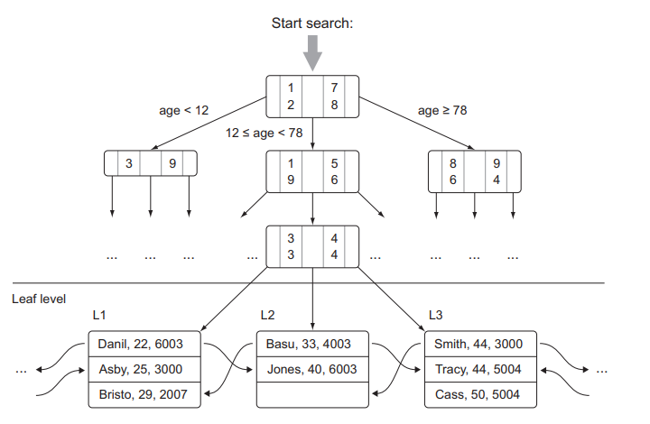
Tree structures

Slide 36
Hash tables
<key, value> key.hashcode() hashtable
<101, A>
<103, B>
<104, C>
<107, D>
<109, E>
Collision and chaining

Slide 37
Collision- A collision happens when two different keys generate the same hash value and try to occupy the same position in the array. Since a hash table must store both keys and values, we need a way to handle these collisions efficiently.
101,A 101%10=1
103,B 103%10=3
111,C 111%10=1
Here collision occurs between two keys 101 and 111 as they have same hash value 1. here a collision has occurred. This can be resolved by chaining.
Instead of storing as single value pair, we can store as linked list. This is known as chaining.

Slide 38
Selecting the right tools
Cython- converts python code into C-like code, which runs faster.
Numexpr – uses just in time compiler to run numerical expressions(NUMPY) efficiently.
Numba – gives high performance on numerical and scientific computations.
Bcolz – stores large numerical data in compressed format to save memory.
Blaze – provides a consistent way to access different databases and data sources. Concerts python commands into sql queries or database friendly operations.
Theano- compiles complex mathematical functions easily.
Dask – enables parallel and distributed computing for large datasets by dividing data into chunks.

Slide 39
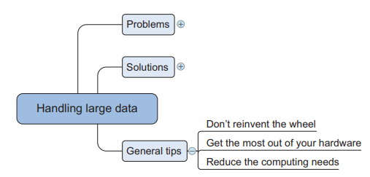
General tips for dealing with large data sets

Slide 40
Don’t reinvent the wheel
Exploit the power of large databases
Use SQL queries and user defined functions inside data bases to preprocess data instead doing everything in python.
2. Use optimized libraries
Mahout – Scalable machine learning for big data (Java-based).
Weka – A collection of machine learning algorithms for data mining.
Scikit-learn, TensorFlow, PyTorch – Optimized Python ML libraries

Slide 41
Get the Most Out of Your Hardware
Feed the CPU Compressed Data: This reduces the load on hard disks and allows the CPU to operate more efficiently.
Utilize the GPU: For parallelizable computations, switch to GPU processing using libraries like Theano or NumbaPro, which require minimal programming effort.
Implement Multi-threading: Use Python threads to parallelize tasks on your CPU, improving computational efficiency.

Slide 42
Reduce Your Computing Needs
Use Compiled Code: Leverage optimized libraries for numerical computations instead of writing everything from scratch.
Avoid Excessive Data Loading: Process data in chunks to manage memory effectively, especially with large datasets.
Sample Your Data: If feasible, train models on a representative sample rather than the entire dataset.
Simplify Calculations: Use mathematical simplifications to speed up computations, such as rearranging equations for efficiency.

